Slide 1
Task 1 Autopilot literature review
Team members
name | sec | bn
Mohammed Ahmed Hassan Ahmed | 2 | 37
Ibrahim Thabet Allam | 1 | 1
Mohammed Hatem Mohammed Saeed | 2 | 39
Mohamed Hassan Gad Ali | 2 | 41
Mohammed Abd El Mawgoud Ghoneam | 2 | 43

Slide 2
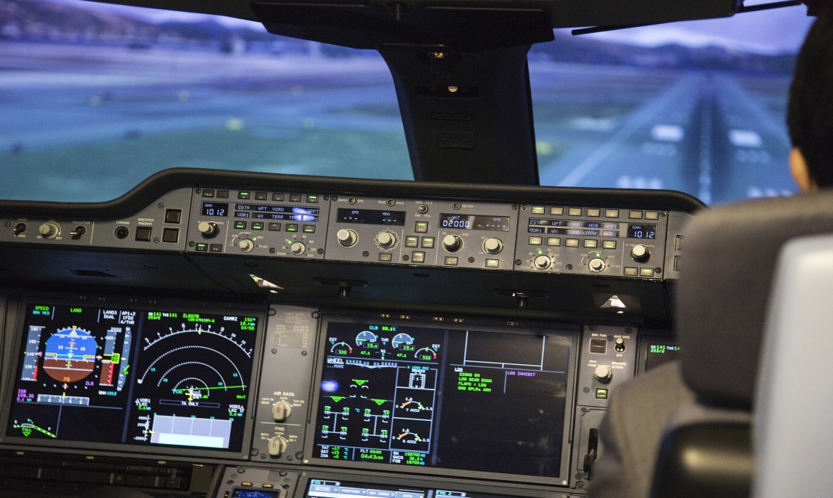
Research questions
Autopilot
An autopilot is a system that allows an airplane to navigate without the need for constant manual control by a human operator

Slide 3
Inputs and outputs of Autopilot system
inputs
Control Inputs:
Radio Control Receivers
MAVLink Data Streams, ie ground control stations or companion computers
Sensor inputs:
GPS, Compass, Airspeed, Rangefinders, IMU
Power Management Unit Inputs:
Received Signal Strength Input (RSSI)
Analog Airspeed Sensors

Slide 4
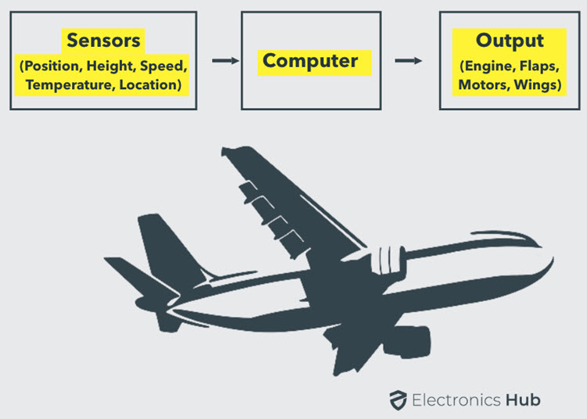
Inputs and outputs of Autopilot system
Outputs
ESCs (electronic circuit that controls and regulates the speed of an electric motor) for motors
Servos for control surfaces
Telemetry data
Actuators and General Purpose I/O like LEDs, buzzers etc

Slide 5
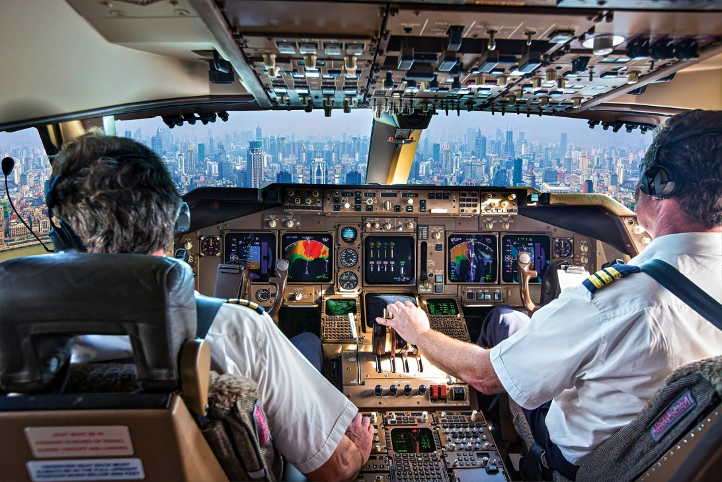
the role of the pilot in an airplane equipped with an autopilot
The pilot sets the flight plan and turn on the autopilot sometimes the pilot reprograms the autopilot in case if worked incorrectly. autopilot is not smart enough to fly a plane by It self

Slide 6
What is the difference between Autopilot & SAS?
SAS (Stability augmentation system) generally used during low and slow maneuvering where the pilot may be making constant attitude changes in preparation for landing.
Autopilot do same functions as SAS in addition it provides more functions ,Autopilot Is more sophisticated than SAS

Slide 7
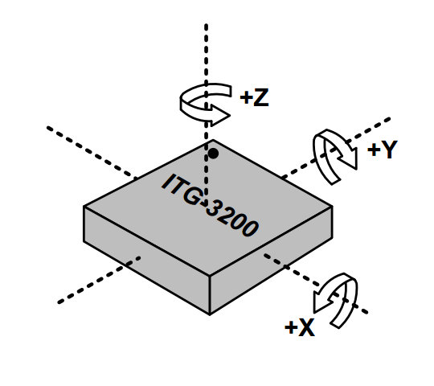
Role of onboard sensors
Sensors provide the autopilot computers with data like speed, coordinates, position so the computers can estimate the states and give the correct control actions to the actuators for example
Gyroscope an IMU supplies the autopilot with position data so if the airplane in incorrect position it gives the actuator signal so that it can adjust position

Slide 8
Flight Mechanics review
Assume
The body is rigid which means the mass is constant and there is no change in geometry (Stress calculations are neglected).
Fix a body axes at the center of mass of the rigid body.

Slide 9


Flight Mechanics review
RBD
calculations of linear momentum:
$$\overset{⃑}{V}= \overset{⃑}{V_{c}}+ \frac{d\overset{⃑}{r}}{dt}$$
$$δ\overset{⃑}{F}= δm\frac{d\overset{⃑}{V}}{dt}$$
$${\frac{d\overset{⃑}{A}}{dt}}_{I}= {\frac{d\overset{⃑}{A}}{dt}}_{B }+ ω × \overset{⃑}{A}$$
$$\overset{⃑}{F}= F_{x}\overset{⃑}{i}+ F_{y}\overset{⃑}{j}+ F_{z}\overset{⃑}{k}$$
$$\overset{⃑}{ω}=P\overset{⃑}{i}+q\overset{⃑}{j}+r\overset{⃑}{k}$$
$$\overset{⃑}{V_{c }}= ui+vj+wk$$
Get
$$F_{x}=m(\dot{u}+qw−rv)$$
$$F_{y}=m(\dot{v}+ru−pw)$$
$$F_{z}=m\left(\dot{w}+pv−qu\right)$$

Slide 10
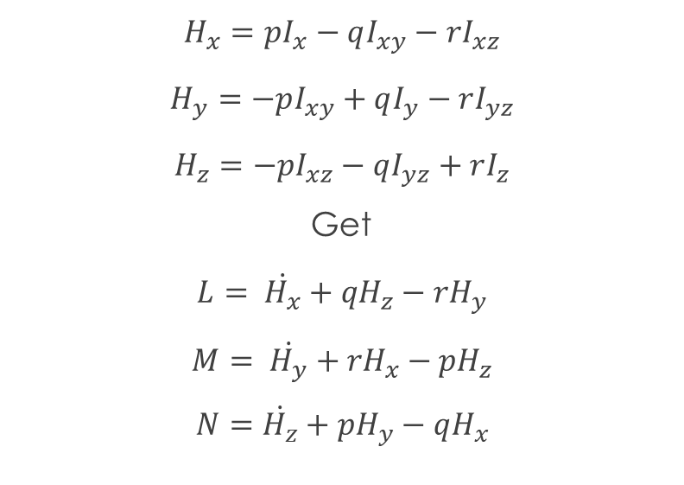
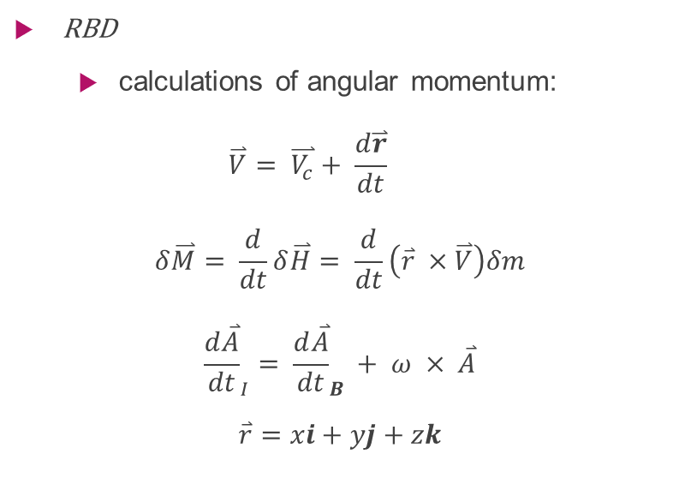
Flight Mechanics review
RBD
calculations of angular momentum:
$$\overset{⃑}{V}= \overset{⃑}{V_{c}}+ \frac{d\overset{⃑}{r}}{dt}$$
$$δ\overset{⃑}{M}= \frac{d}{dt}δ\overset{⃑}{H}= \frac{d}{dt}\left(\overset{⃑}{r} ×\overset{⃑}{V}\right)δm$$
$${\frac{d\overset{⃑}{A}}{dt}}_{I}= {\frac{d\overset{⃑}{A}}{dt}}_{B }+ ω × \overset{⃑}{A}$$
$$\overset{⃑}{r}=xi+yj+zk$$
$$H_{x}=pI_{x}−qI_{xy}−rI_{xz}$$
$$H_{y}=−pI_{xy}+qI_{y}−rI_{yz}$$
$$H_{z}=−pI_{xz}−qI_{yz}+rI_{z}$$
Get
$$L= \dot{H_{x}}+{qH}_{z}−rH_{y}$$
$$M= \dot{H_{y}}+{rH}_{x}−pH_{z}$$
$$N=\dot{H_{z}}+pH_{y}−qH_{x}$$

Slide 11

Flight Mechanics review
Now we are dealing with an aircraft which means that $I_{xy}=I_{yz}=0 \left(symmetry cond.\right)$
$$L=I_{x}\dot{p}−I_{xz}\dot{r}+qr\left(I_{z}−I_{y}\right)−I_{xz}pq$$
$$M=y\dot{q}+rp\left(I_{x}−I_{z}\right)+I_{xz}\left(p^{2}−r^{2}\right)$$
$$N={−I}_{xz}\dot{p}+I_{z}\dot{r}+pq\left(I_{y}−I_{x}\right)+I_{xz}qr$$

Slide 12

Flight Mechanics review
earth axis to body axis transformation:
$\left[\begin{aligned}X_{1} \\ Y_{1} \\ Z_{1}\end{aligned}\right]= \left[\begin{matrix}cosψ & sinψ & 0 \\ −sinψ & cosψ & 0 \\ 0 & 0 & 1\end{matrix}\right] \left[\begin{aligned}X_{E} \\ Y_{E} \\ Z_{E}\end{aligned}\right]$
$$F_{1}=R_{3}\left(ψ\right)F_{E}$$

Slide 13

Flight Mechanics review
earth axis to body axis transformation:
$$\left[\begin{aligned}X_{2} \\ Y_{2} \\ Z_{2}\end{aligned}\right]=\left[\begin{matrix}cosθ & 0 & −sinθ \\ 0 & 1 & 0 \\ sinθ & 0 & cosθ\end{matrix}\right] \left[\begin{aligned}X_{1} \\ Y_{1} \\ Z_{1}\end{aligned}\right]$$
$$F_{2}=R_{2}\left(θ\right)F_{1}= R_{2}\left(θ\right)R_{3}\left(ψ\right)F_{E}$$

Slide 14

Flight Mechanics review
earth axis to body axis transformation:
$$\left[\begin{aligned}X_{B} \\ Y_{B} \\ Z_{B}\end{aligned}\right]= \left[\begin{matrix}1 & 0 & 0 \\ 0 & cosφ & sinφ \\ 0 & −sinφ & cosφ\end{matrix}\right] \left[\begin{aligned}X_{2} \\ Y_{2} \\ Z_{2}\end{aligned}\right]$$
$$F_{B}=R_{1}\left(φ\right)F_{2}= R_{1}\left(φ\right)R_{2}\left(θ\right)R_{3}\left(ψ\right)F_{E}$$

Slide 15
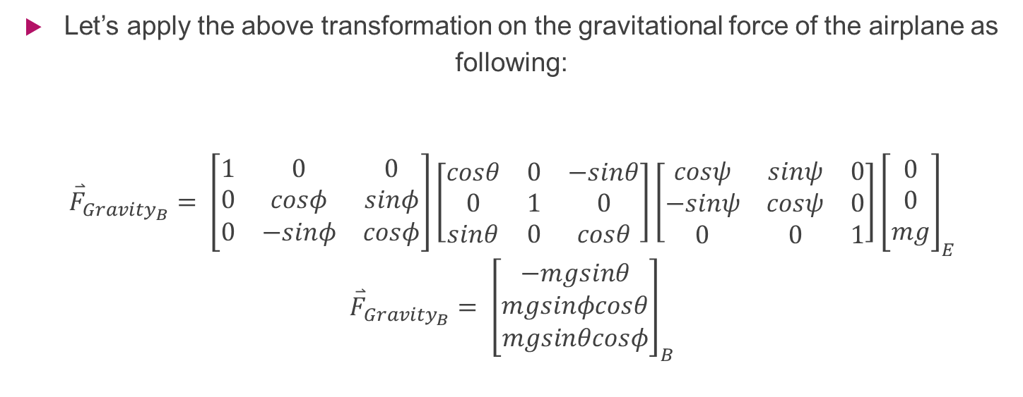
Flight Mechanics review
Let’s apply the above transformation on the gravitational force of the airplane as following:
$${\overset{⃑}{F}}_{{Gravity}_{B}}= \left[\begin{matrix}1 & 0 & 0 \\ 0 & cosφ & sinφ \\ 0 & −sinφ & cosφ\end{matrix}\right]\left[\begin{matrix}cosθ & 0 & −sinθ \\ 0 & 1 & 0 \\ sinθ & 0 & cosθ\end{matrix}\right]\left[\begin{matrix}cosψ & sinψ & 0 \\ −sinψ & cosψ & 0 \\ 0 & 0 & 1\end{matrix}\right]{\left[\begin{aligned}0 \\ 0 \\ mg\end{aligned}\right]}_{E}$$
$${\overset{⃑}{F}}_{{Gravity}_{B}}= {\left[\begin{aligned}−mgsinθ \\ mgsinφcosθ \\ mgsinθcosφ\end{aligned}\right]}_{B}$$

Slide 16

Flight Mechanics review
Then:
$$−mgsinθ+{F_{T}}_{X}=m(\dot{u}+qw−rv)$$
$$mgsinφcosθ+{F_{T}}_{Y} =m(\dot{v}+ru−pw)$$
$$mgsinθcosφ + {F_{T}}_{Z}=m\left(\dot{w}+pv−qu\right)$$

Slide 17
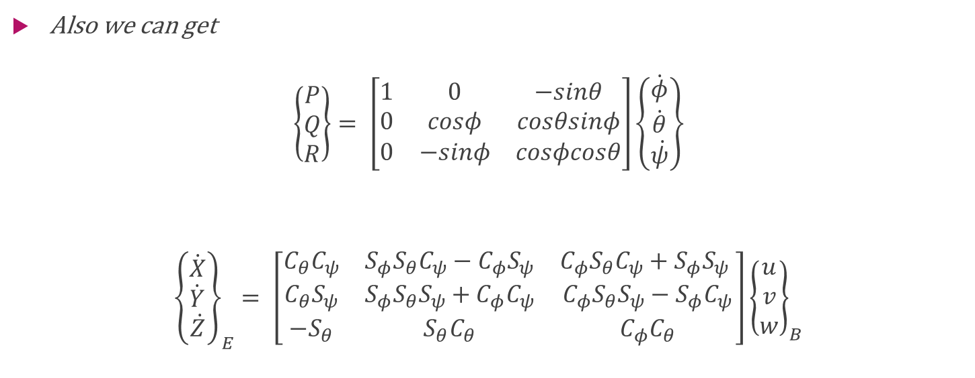
Flight Mechanics review
Also we can get
$$\left\{\begin{aligned}P \\ Q \\ R\end{aligned}\right\}= \left[\begin{matrix}1 & 0 & −sinθ \\ 0 & cosφ & cosθsinφ \\ 0 & −sinφ & cosφcosθ\end{matrix}\right]\left\{\dot{\begin{aligned}φ \\ \dot{\begin{aligned}θ \\ \dot{ψ}\end{aligned}}\end{aligned}}\right\}$$
$${\left\{\dot{\begin{aligned}X \\ \dot{\begin{aligned}Y \\ \dot{Z}\end{aligned}}\end{aligned}}\right\}}_{E}= \left[\begin{matrix}C_{θ}C_{ψ} & S_{φ}S_{θ}C_{ψ}−C_{φ}S_{ψ} & C_{φ}S_{θ}C_{ψ}+S_{φ}S_{ψ} \\ C_{θ}S_{ψ} & S_{φ}S_{θ}S_{ψ}+C_{φ}C_{ψ} & C_{φ}S_{θ}S_{ψ}−S_{φ}C_{ψ} \\ −S_{θ} & S_{θ}C_{θ} & C_{φ}C_{θ}\end{matrix}\right]{\left\{\begin{aligned}u \\ v \\ w\end{aligned}\right\}}_{B}$$

Slide 18
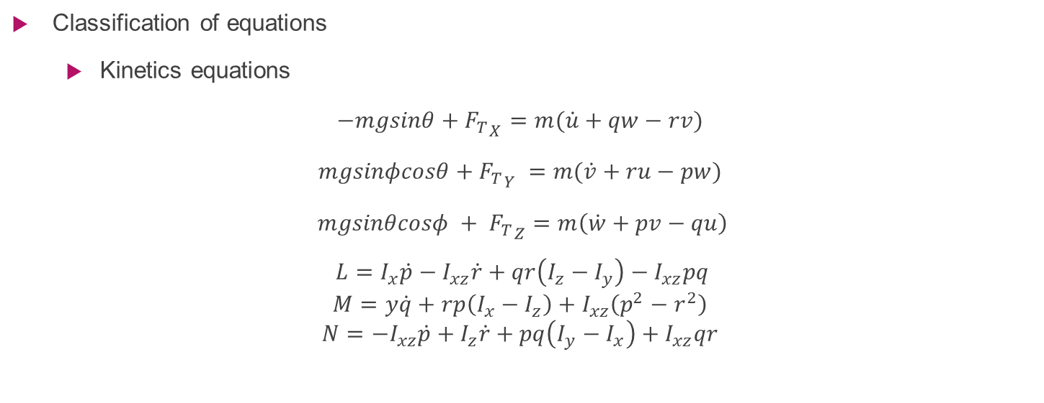
Flight Mechanics review
Classification of equations
Kinetics equations
$$−mgsinθ+{F_{T}}_{X}=m(\dot{u}+qw−rv)$$
$$mgsinφcosθ+{F_{T}}_{Y} =m(\dot{v}+ru−pw)$$
$$mgsinθcosφ + {F_{T}}_{Z}=m\left(\dot{w}+pv−qu\right)$$
$$L=I_{x}\dot{p}−I_{xz}\dot{r}+qr\left(I_{z}−I_{y}\right)−I_{xz}pq$$
$$M=y\dot{q}+rp\left(I_{x}−I_{z}\right)+I_{xz}\left(p^{2}−r^{2}\right)$$
$$N={−I}_{xz}\dot{p}+I_{z}\dot{r}+pq\left(I_{y}−I_{x}\right)+I_{xz}qr$$

Slide 19
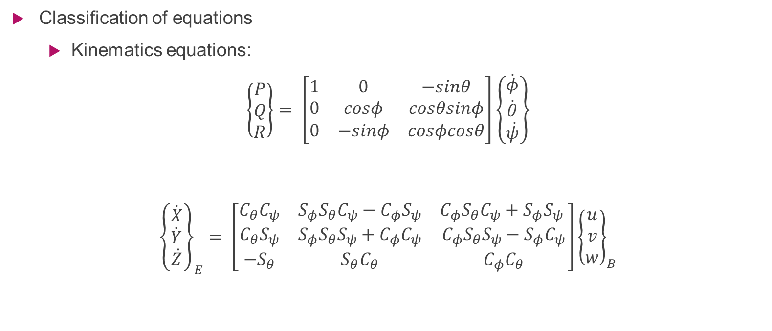
Flight Mechanics review
Classification of equations
Kinematics equations:
$$\left\{\begin{aligned}P \\ Q \\ R\end{aligned}\right\}= \left[\begin{matrix}1 & 0 & −sinθ \\ 0 & cosφ & cosθsinφ \\ 0 & −sinφ & cosφcosθ\end{matrix}\right]\left\{\dot{\begin{aligned}φ \\ \dot{\begin{aligned}θ \\ \dot{ψ}\end{aligned}}\end{aligned}}\right\}$$
$${\left\{\dot{\begin{aligned}X \\ \dot{\begin{aligned}Y \\ \dot{Z}\end{aligned}}\end{aligned}}\right\}}_{E}= \left[\begin{matrix}C_{θ}C_{ψ} & S_{φ}S_{θ}C_{ψ}−C_{φ}S_{ψ} & C_{φ}S_{θ}C_{ψ}+S_{φ}S_{ψ} \\ C_{θ}S_{ψ} & S_{φ}S_{θ}S_{ψ}+C_{φ}C_{ψ} & C_{φ}S_{θ}S_{ψ}−S_{φ}C_{ψ} \\ −S_{θ} & S_{θ}C_{θ} & C_{φ}C_{θ}\end{matrix}\right]{\left\{\begin{aligned}u \\ v \\ w\end{aligned}\right\}}_{B}$$

Slide 20
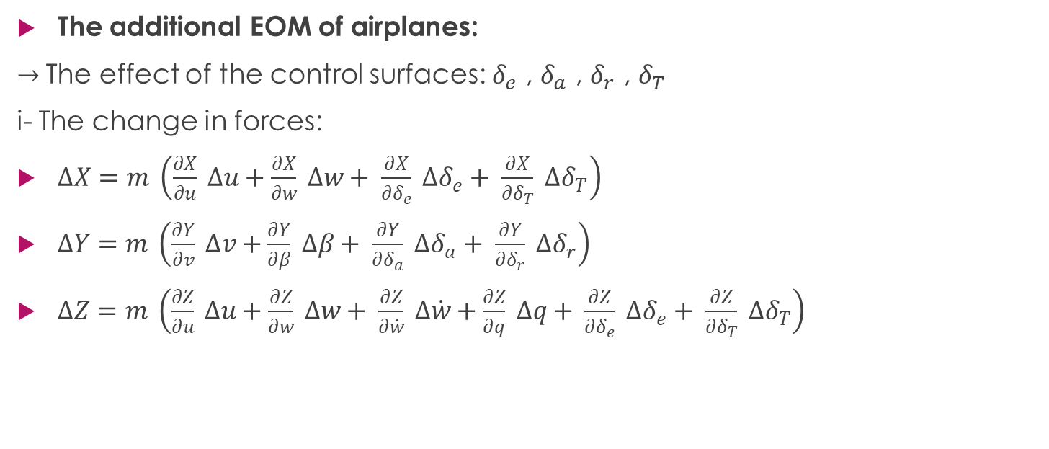
Flight Mechanics review
The additional EOM of airplanes:
$→$The effect of the control surfaces: $δ_{e}$ , $δ_{a}$ , $δ_{r}$ , $δ_{T}$
i- The change in forces:
$∆X=m \left(\frac{∂X}{∂u} ∆u+\frac{∂X}{∂w} ∆w+ \frac{∂X}{∂δ_{e}} ∆δ_{e}+ \frac{∂X}{∂δ_{T}} ∆δ_{T}\right)$
$∆Y=m \left(\frac{∂Y}{∂v} ∆v+\frac{∂Y}{∂β} ∆β+ \frac{∂Y}{∂δ_{a}} ∆δ_{a}+ \frac{∂Y}{∂δ_{r}} ∆δ_{r}\right)$
$∆Z=m \left(\frac{∂Z}{∂u} ∆u+\frac{∂Z}{∂w} ∆w+ \frac{∂Z}{∂\dot{w}} ∆\dot{w}+\frac{∂Z}{∂q} ∆q+ \frac{∂Z}{∂δ_{e}} ∆δ_{e}+ \frac{∂Z}{∂δ_{T}} ∆δ_{T}\right)$

Slide 21
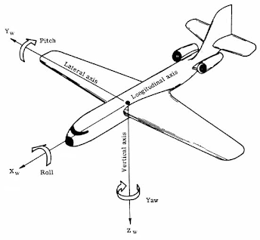
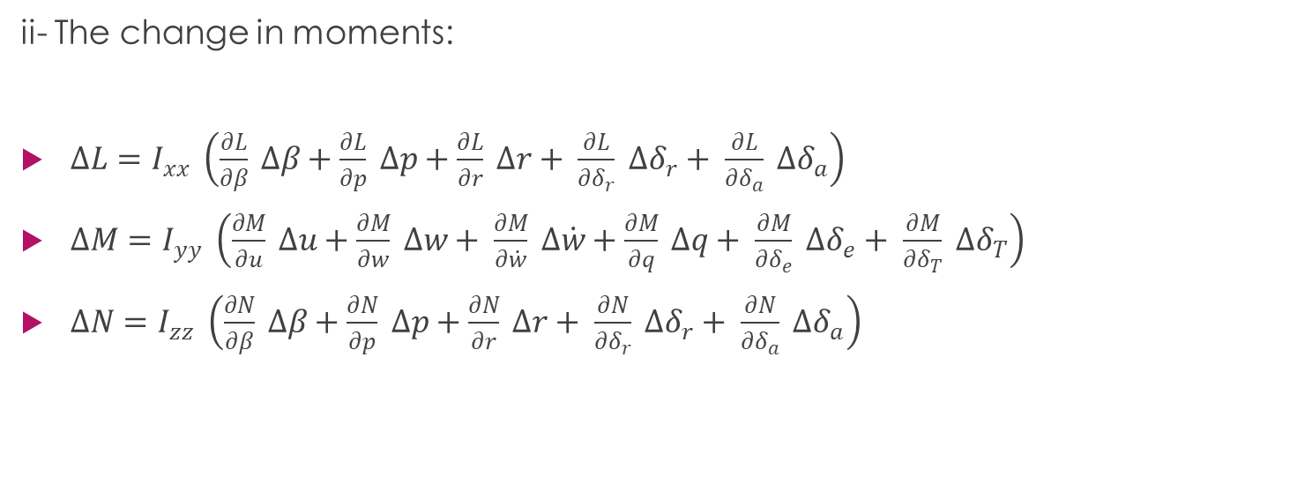
Flight Mechanics review
ii- The change in moments:
$∆L=I_{xx} \left(\frac{∂L}{∂β} ∆β+\frac{∂L}{∂p} ∆p+\frac{∂L}{∂r} ∆r+ \frac{∂L}{∂δ_{r}} ∆δ_{r}+ \frac{∂L}{∂δ_{a}} ∆δ_{a}\right)$
$∆M=I_{yy} \left(\frac{∂M}{∂u} ∆u+\frac{∂M}{∂w} ∆w+ \frac{∂M}{∂\dot{w}} ∆\dot{w}+\frac{∂M}{∂q} ∆q+ \frac{∂M}{∂δ_{e}} ∆δ_{e}+ \frac{∂M}{∂δ_{T}} ∆δ_{T}\right)$
$∆N=I_{zz} \left(\frac{∂N}{∂β} ∆β+\frac{∂N}{∂p} ∆p+\frac{∂N}{∂r} ∆r+ \frac{∂N}{∂δ_{r}} ∆δ_{r}+ \frac{∂N}{∂δ_{a}} ∆δ_{a}\right)$

Slide 22
Flight Mechanics review
The EOM’s are coupled, nonlinear and first order DE.
Difference bet. Body & inertial Axes
Body axes: they are a set of axes which are fixed at the body in its translational and rotations.
Inertial axes: they are a set of axes which are fixed at a specified position on the ground.

Slide 23
Flight Mechanics review
Pitch angle: it’s the angle between the body y-axis and the horizon.
AOA: the angle at which the chord of an aircraft's wing meets the relative wind.
Sideslip angle: it’s formed due to lateral deviation between the plane and the direction of the flow.
Yaw angle (heading): it’s formed due to the rotation about z-axis.

Slide 24
numerical solving algorithms for ODE
One-step methods, like:
Multistep methods, like:
Other methods
Euler-Cauchy method
Improved Euler method
Raunge-Kutta method
Backward Euler method
Adams-Bash forth method
Adams-Moulton method
Predector –coeector methods
Exponential integrator methods

Slide 25
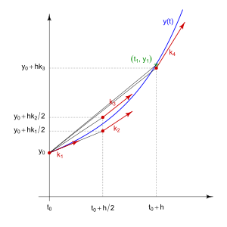
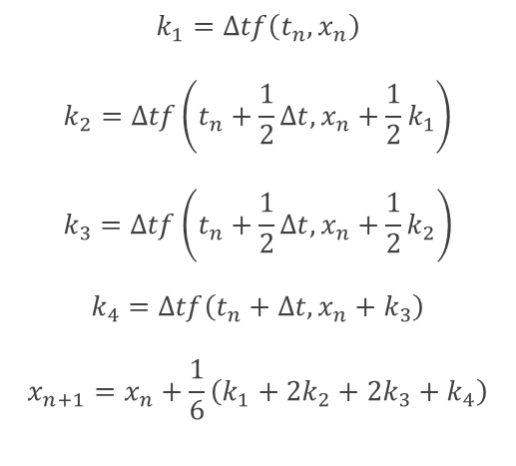
The chosen method for solving the aircraft EOM
4th order Runge-Kutta
We choose to use Raunge-Kutta method since its one of the most accurate one step methods used in the numerical solutions, in addition it’s the method used in the MATLAB ODE45 algorithm.
$$k_{1}=Δtf\left(t_{n},x_{n}\right)$$
$$k_{2}=Δtf\left(t_{n}+\frac{1}{2}Δt,x_{n}+\frac{1}{2}k_{1}\right)$$
$$k_{3}=Δtf\left(t_{n}+\frac{1}{2}Δt,x_{n}+\frac{1}{2}k_{2}\right)$$
$$k_{4}=Δtf\left(t_{n}+Δt,x_{n}+k_{3}\right)$$
$$x_{n+1}=x_{n}+\frac{1}{6}\left(k_{1}+2k_{2}+2k_{3}+k_{4}\right)$$

